Slide 1
Resilience-Building through Savings Groups
Preliminary Survey Findings
Prepared by the BRCiS Evidence and Learning Team

Slide 2
In this deck
This slide deck contains top-level findings from a phone survey with ~430 Village Savings and Loan Association (VSLA) and Self-Help Group (SHGs) participants under the Building Resilient Communities in Somalia (BRCiS) Consortium.
Savings groups are commonly used interventions by NGOs working in fragile contexts to build the resilience of vulnerable groups against recurring shocks. Yet, rigorous evidence demonstrating specific impacts is still nascent in the context of Somalia. BRCiS aims to contribute to ongoing learning efforts by analyzing its own savings group activities, building on available operational data and survey insights from group participants.
Principally, this analysis seeks to answer three main group of questions, alongside other aspects such as gender dynamics and female empowerment.
1) How does participation in VSLAs/SHGs affect resilience capacities at household and community level?
2) How does savings and loans performance vary based on the modality of groups (VSLA vs SHG models)?
3) Is there any variation between the observed impacts of VSLA vs. SHG groups across different livelihood settings? Put it differently, are VSLA/SHGs better suited to specific livelihoods contexts?

Slide 3
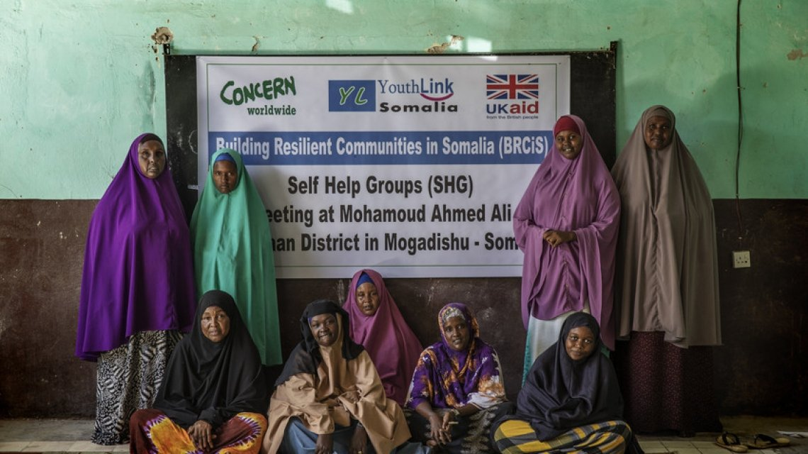
Self-Help Group Participants in Karaan District, Mogadishu, Somalia (2020)

Slide 4
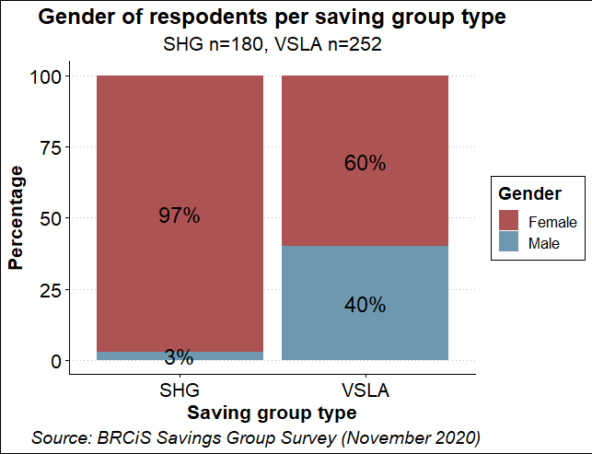
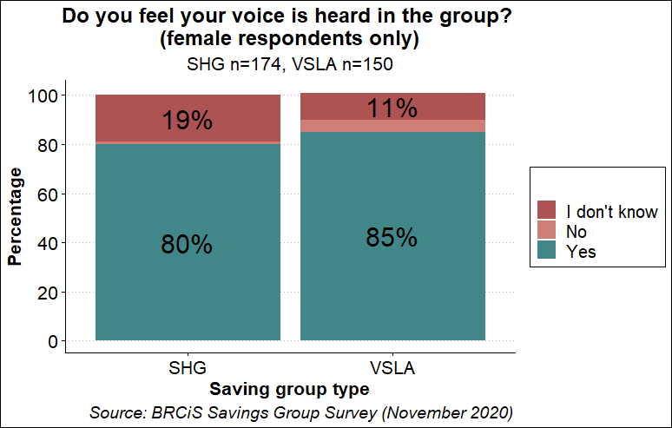
EXECUTIVE SUMMARY
Headlines on Gender
1
Different approaches to female empowerment
Both savings group modalities seek to enhance female empowerment, but rely on markedly different strategies. SGHs are exclusively operated with female members, while VSLAs have a mixed gender balance with 2 in 5 members being male on average (p XX). In some extreme cases like in Hudur or Elbarde, the groups are predominantly male, posing additional challenges to enhancing female voice and participation.
2
Preliminary insights showed similar results
On average, SHG Members value self-empowerment more, particularly in urban areas, compared to VSLAs. Somewhat surprisingly, still about 80-85% of female VSLAs and SHG Members said that their voice are heard despite the mixed gender balance observed; though results are too early to draw far-reaching conclusions.

Slide 5
EXECUTIVE SUMMARY
Headlines on Group Performance
8 in 10 SHG participants reported meeting up every week, while VSLAs most typically interact with each other every second week
Both VSLA and SHG groups report to save more during Jilaal, primarily linked to previous good harvest, growing livestock prices but drought conditions could change this picture
As of now, VSLA managed to give out more loans compared to SHGs (52% vs 32%), but members of both groups have high confidence that borrowers will be able to pay back their loans

Slide 6
EXECUTIVE SUMMARY
Headlines on Group Performance
Targeting and Group Composition
Both savings group modalities seek to enhance female empowerment, but their strategies are markedly different. SGHs are exclusively operated with female members, while VSLAs have a mixed gender balance with 2 in 5 members being male on average.
In some cases, like in Hudur or Elbarde, the groups are predominantly male, possibly hindering female representation and voice but this should be further explored through KIIs and FGDs
Somewhat surprisingly, still about 80-85% of female VSLAs and SHG Members said that their voice are heard despite the mixed gender balance highlighted earlier
On average, SHG Members value self-empowerment more, particularly in urban areas
Group Performance
& Loan/Savings Capacity
8 in 10 SHG participants reported meeting up every week, while VSLAs most typically interact with each other every second week
Both VSLA and SHG groups report to save more during Jilaal, primarily linked to previous good harvest, growing livestock prices but drought conditions could change this picture
As of now, VSLA managed to give out more loans compared to SHGs (52% vs 32%), but members of both groups have high confidence that borrowers will be able to pay back their loans

Slide 7
EXECUTIVE SUMMARY
Headlines on Household Resilience Capacities
HH-Level Benefits
About the use of loans, VSLAs tend to invest more into productive assets, while SHG Members prioritise education and health
When asked about the most significant impact of group membership, around half of VSLA respondents didn’t report any impact at the time of the survey, while more than one in five SHGs Members indicated seeing a transformative impact, citing increased income and business activities, education and food access
In line with this finding, SHG reports a significantly higher confidence in their perceived capacity to recover from future shocks compared to VSLAs (52% vs. 37%)
Community-wide Benefits
Around half of SGH and VSLA groups reported maintaining social funds, which are used to support group members or other vulnerable individuals in times of need and to contribute to community projects
Linked to this, both VSLAs and SHGs seem to be well-embedded in their communities, but VSLA members meet community representatives more often and have more impact on community decision-making (possibly explained by the higher number of males present in the group)
Between 33-40% reports to have engaged in activities that benefitted the wider community, the nature of this assistance should be further unpacked qualitatively

Slide 8
EXECUTIVE SUMMARY
Headlines on Community Resilience Capacities
HH-Level Benefits
About the use of loans, VSLAs tend to invest more into productive assets, while SHG Members prioritise education and health
When asked about the most significant impact of group membership, around half of VSLA respondents didn’t report any impact at the time of the survey, while more than one in five SHGs Members indicated seeing a transformative impact, citing increased income and business activities, education and food access
In line with this finding, SHG reports a significantly higher confidence in their perceived capacity to recover from future shocks compared to VSLAs (52% vs. 37%)
Community-wide Benefits
Around half of SGH and VSLA groups reported maintaining social funds, which are used to support group members or other vulnerable individuals in times of need and to contribute to community projects
Linked to this, both VSLAs and SHGs seem to be well-embedded in their communities, but VSLA members meet community representatives more often and have more impact on community decision-making (possibly explained by the higher number of males present in the group)
Between 33-40% reports to have engaged in activities that benefitted the wider community, the nature of this assistance should be further unpacked qualitatively

Slide 9
Implications
Discuss for the Quality Benchmark Document
Gender balance in savings groups:
Shall there be a recommend ratio?
How are we making sure that male-dominated groups promote female empowerment?
Use of cash injections
Are these given to all group members or only to the most vulnerable in a group?
If only the most vulnerable gets it, how does this affect group dynamics and cohesion? Any negative consequences to mitigate? Shall we further explore this together?
Capture in the Quarterly Reporting Template
Continue tracking loan defaults and savings rates
Recommend adding:
Gender ratio of savings groups
Attrition rate
Existence and use of social funds
Community-wide benefits (maybe a Case Study?)
Include in Future Surveys and Interviews
Look at how savings group participation build resilience capacities to shocks
Unpack more how savings groups support other community members
Anything else?
Notes:
Questions from FCDO:
do we think the different gender dynamics could be influencing how loans are used between the two groups?
do we have both types of groups in some communities? Should we have?
2. Any plans of influencing to improve representation in male dominated groups
Based on the findings, do we expect a possible shift towards one of the approaches (VSLA vs SHG) in future or keep the status quo
Plans on how to combine savings group and IGA - layering with skills-building activities
how we can we use these groups to build community resilience?
Paz:
sorry I had a power cut and lost connection temporarily. Just wanted to add that we are also seeing SHG impact enhanced when introducing group cash injections to mature groups to develop business loan revolving funds and when SHG groups federate to mutualise their capital, increasing their capacity to provide loans to women which are otherwise excluded from formal and often informal microfinance services
Based on the findings, do we expect a possible shift towards one of the approaches (VSLA vs SHG) in future or keep the status quo
Plans on how to combine savings group and IGA - layering with skills-building activities
how we can we use these groups to build community resilience?

Slide 10
Strategic Questions from FCDO
Do we think the different gender dynamics could be influencing how loans are used between the two groups?
Do we have both types of groups in some communities? Should we have?
Any plans of influencing to improve representation in male dominated groups (for AHH?)
Based on the findings, do we expect a possible shift towards one of the approaches (VSLA vs SHG) in future or keep the status quo
Plans on how to combine savings group and IGA - layering with skills-building activities
how we can we use these groups to build community resilience?

Slide 11
CONTENTS
Review of Evidence
Intervention Details
Survey Findings

Slide 12
Review of Evidence
Growing body of evidence on the positive impacts of SHG and VSLA on resilience and food security
Six Strategic Insights Based on Latest Global Knowledge
1
Strong evidence on the effect on business outcomes and female empowerment; though, programme design matters to a great extent
Both VSLA and SHGs were found to be continuing after NGO facilitation ended
4
Improvement in food security and resilience to shocks through increased profits and assets building - but depends on the context
5
2
The impacts are shown over the first 3-5 of years of group membership
Impacts on education and health spending are less clear and somewhat more common for SHGs compared to VSLAs
6
Greater sustainability results if groups are larger with a flexible mandate and processes and when linked to financial services
3
Highlighted findings were adopted based on a 2016 review of 18 studies covering academic articles and reports in the grey literature. Source at this link.

Slide 13
Review of Evidence
In contrast, studies applying rigorous methodologies showed more modest and context-specific results
Research using Randomized Control Trials (RCT) identified more modest positive impacts
Year | Countries | Method | Interv. | + Impacts | 0 Impacts | VfM | Source
2016 | Malawi Uganda | RCT | VSLA | Business outcomes; Empowerment; Improved food security and income during drought | HH income; Consumption; Food security; Asset ownership | Av. cost per HH was 7-11 USD . | Link
2013 | Mali | RCT | VSLA | Improved food security (more connected women more likely to participate) | Business activities; investments in agriculture; health, education, social capital
2013 | Burundi (IRC) | RCT | VSLA | 23% growth in consumption Large increases in HH assets More spending on education | VSLA alone did not have an impact on child wellbeing No impact on health spending |  | Link

Slide 14
Review of Evidence
The state of evidence on saving groups in Somalia is still nascent
Most evaluations are qualitative in nature, rarely backed up with rigorous operational data
Year | Author | Interv. | Methodology | Findings
2020 | KAALO | VSLA | Mixed method | - Positive impacts on 1) access to credit from MFIs, 2) training 3) trust 4) women empowerment 5) spending on education
2019 | ShareTrust BRCiS | SHGs | Ecosystem mapping | - Areas that require further investments in SL context include access to government services and links to micro-finance institutions - Evidence is limited but growing, making evidence building a key priority
2018 | SOMREP, Somalia | VSLA | Positive Deviance | Positive impacts on 1) food security 2) bridging social capital 3) self-esteem
2016 | CARE, Puntland | VSLA | Qualitative | - Largely positive perception across most outcomes - Difficulties around operating VSLA in IDP settings due to mobility and community dynamics
2015 | Somaliland | SHGs | Qualitative | - Anecdotal evidence on social support to poor household member - Increase in financial and social capital
2013 | USAID, Ethiopia | SHGs | VfM | - High impacts and low costs with a benefit to cost ratio ranging from 58:1 to 173:1

Slide 15
CONTENTS
Review of Evidence
Intervention Details
Survey Findings

Slide 16
Intervention Details
BRCiS pilots two common savings groups modalities with ~ 2,500 participants in Phase 2 (2019-2022)
Distinct characteristics
VSLAs
Commonalities
- Open to both genders (15-25)
- Members need to buy at least 1 share and upto 5 shares at every meeting
- Annual sharouts of cash or when participants need it
- Individual loans
- New members can join at the end of each cycle
- Social fund site aside
- Community-based savings-led microfinance
- Regular meetings with pre-agreed contributions
- Economic and female empowerment
Distinct characteristics
- Women only (10-20)
- Contribution at every meeting
- No annual share-out but occasional dividend to members
- Individual and group loans
- where possible, linked to formal banking institution
SHGs

Slide 17
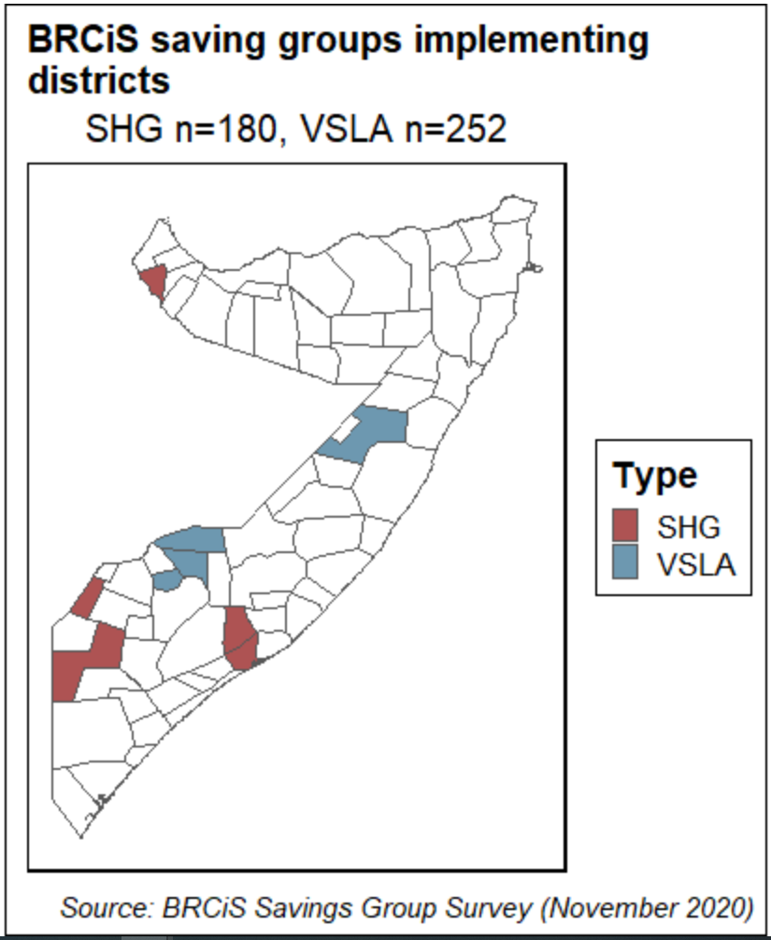
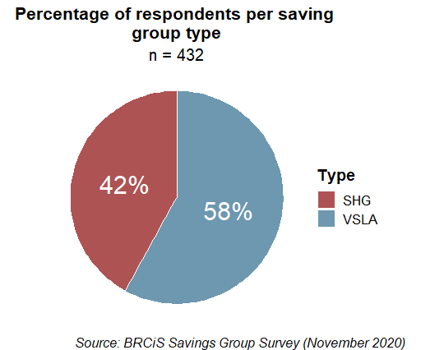
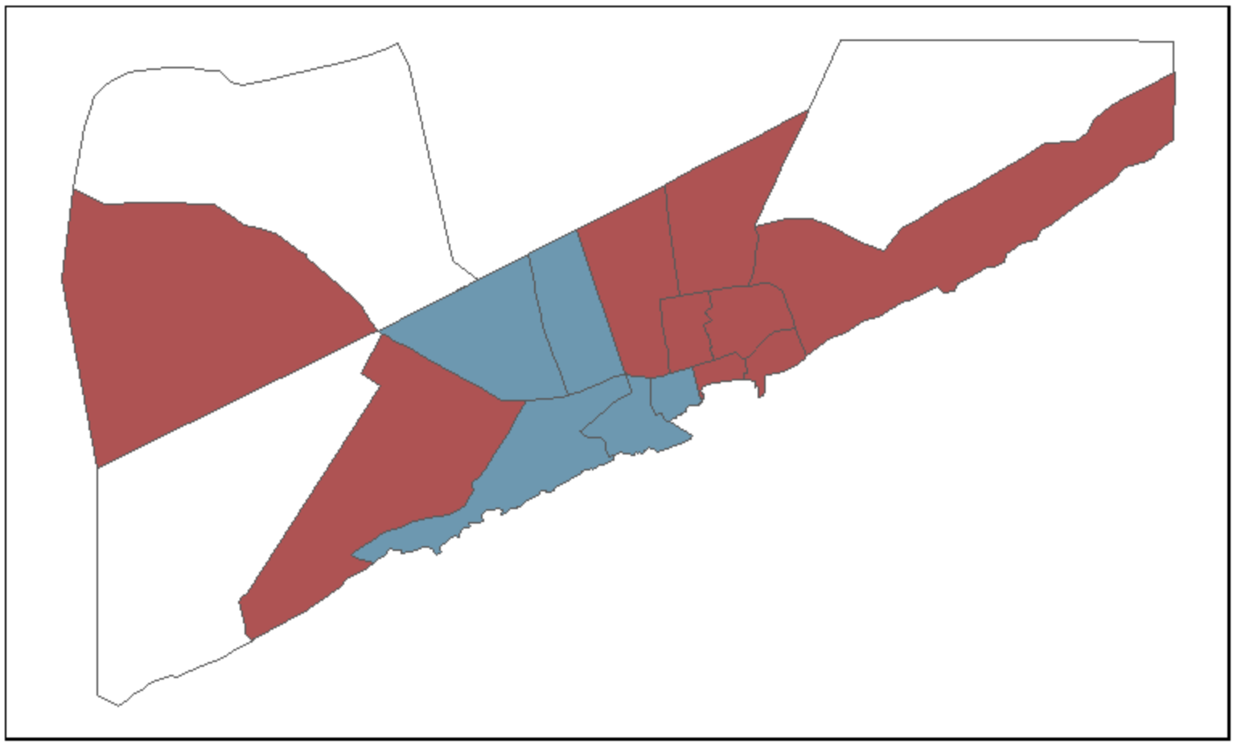
Intervention Details
Exploratory survey with the first cohort of SHGs and VSLAs to learn more about group performance in different livelihoods settings
Main Survey Parameters
Phone survey six months after graduation between 9/11 & 17/11 with a sample of 432 respondents
Involving 3 Members CWW, IRC & AHH with 180, 55 and 197 respondents, respectively, in 14 districts
About 60% are VSLA participant
Notes:
Pie chart by ggplot, insert the source within the visual as a caption, applicable to all visuals, always highlight date in the caption and number of observation (n = 432) should be in title or the subtitle.

Slide 18
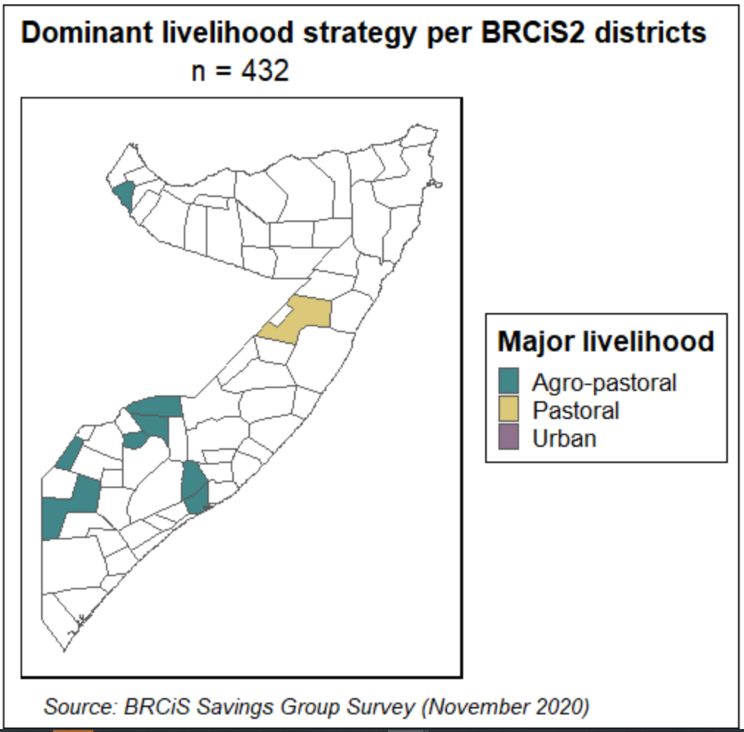
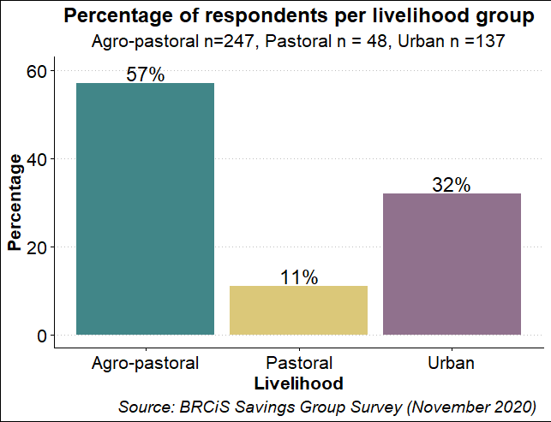
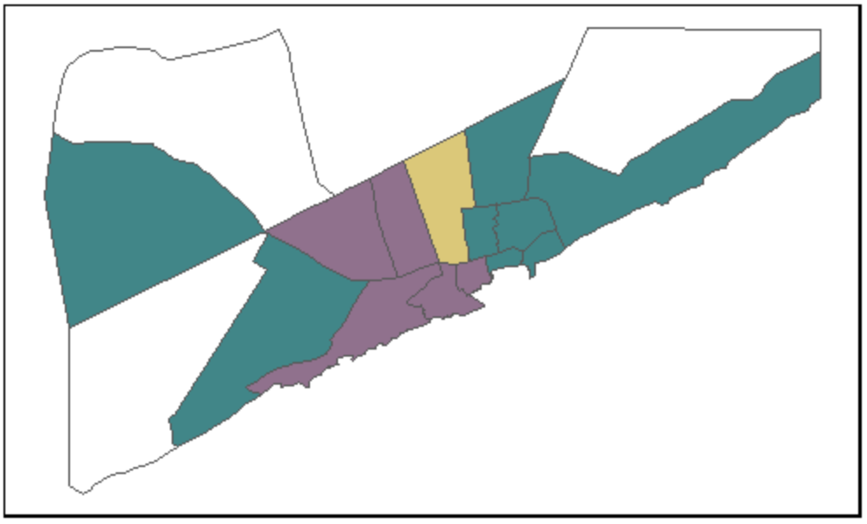
Intervention Details
SHGs and VSLAs are piloted across three dominant livelihoods contexts
The first cohort included agro-pastoral, urban and pastoral communities

Slide 19
CONTENTS
Review of Evidence
Intervention Details
Survey Findings

Slide 20
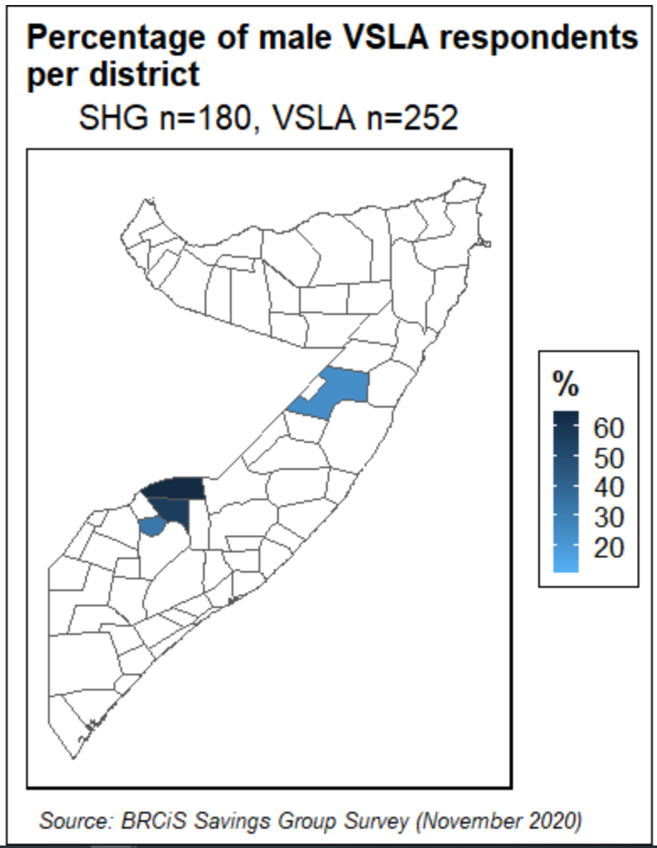
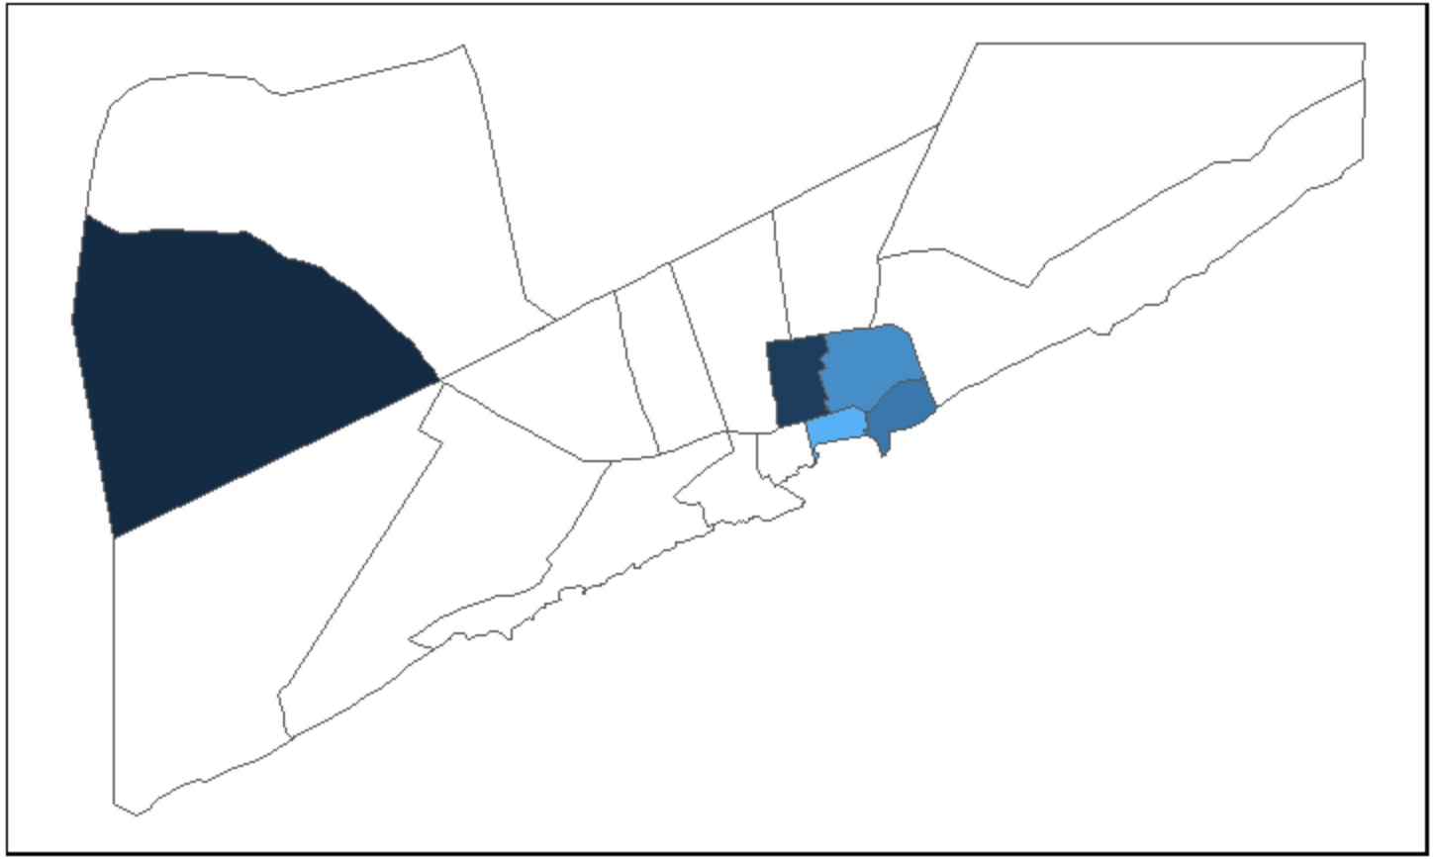
Targeting and Demographics
Clear differences in gender balance between VSLAs and SHGs
SHGs are almost exclusively implemented with females, while VSLAs are more balanced
Groups in Hudur and Elbarde overwhelmingly male with implications to female empowerment efforts

Slide 21
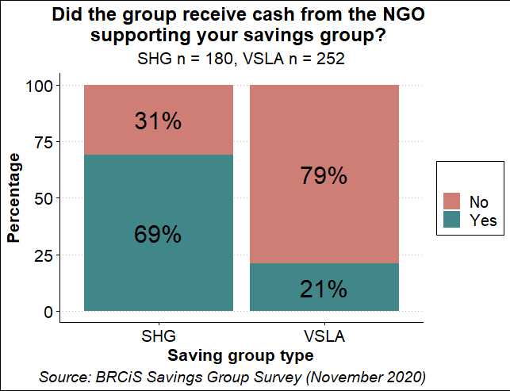
Targeting and Demographics
Cash injections are more common among SHGs, and primarily applied to enable the participation of vulnerable community members
 | VSLA |  |  | SHG
Livezone | No | Yes | N | No | Yes | N | Total N
Agro-pastoral | 91.2% | 8.8% | 147 | 21% | 79% | 100 | 247
Pastoral | 47.1% | 52.9% | 34 | 78.6% | 21.4% | 14 | 48
Urban | 69% | 31% | 71 | 34.8% | 65.2% | 66 | 137
 | 69.1% | 30.9% | 84 | 44.8% | 55.2% | 60 | 144
Notes:
Revise caption

Slide 22
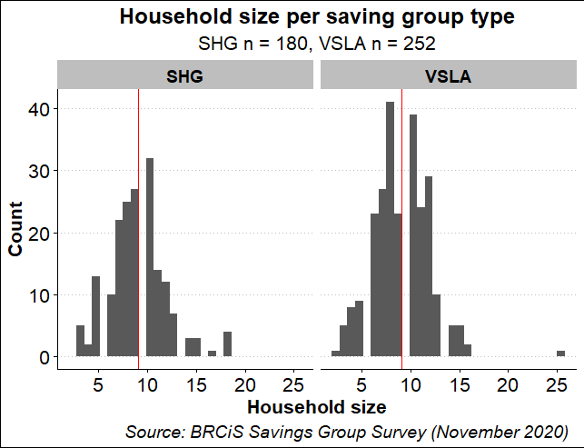
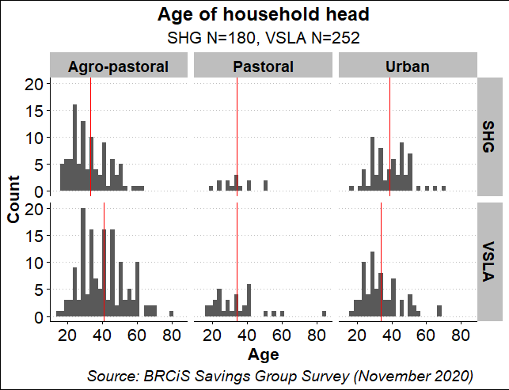
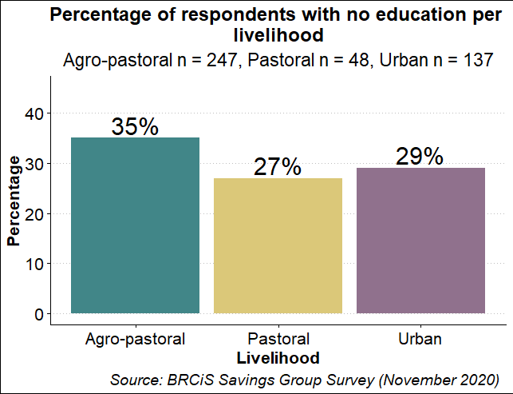
Targeting and Demographics
SHG and VSLS Members share similar demographic characteristics
The average HH size is around 9 both for VSLA and SHG
The av. age is 36 with younger members in urban areas
About one third with no education

Slide 23
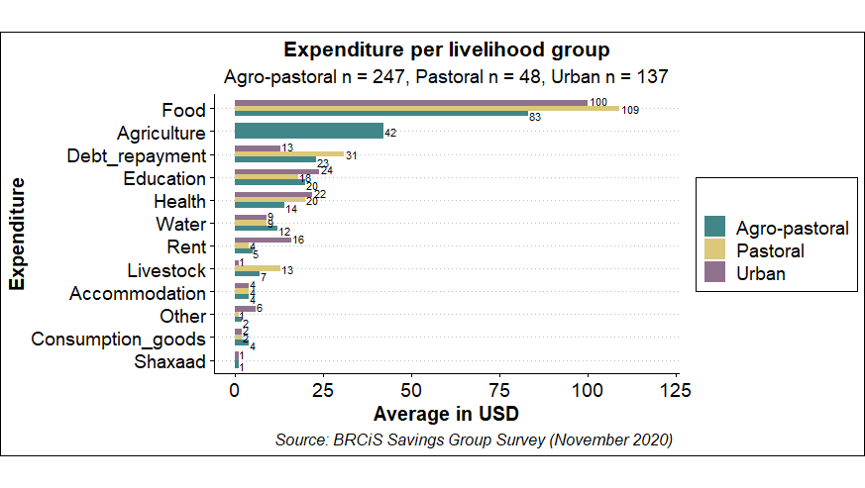
Targeting and Demographics
Clear link between expenditure patterns and livelihoods
Urban households spend more on health and education and have larger expenses on rent
Rural residents have larger debts and invest more into agriculture and livestock
Notes:
Lollipop chart

Slide 24
Impacts of C-19
Marked impacts on urban livelihoods in June, primarily caused by movement restrictions
Three ways C19 affected the livelihoods and food security of savings groups:
1 Limited opportunities to engage in daily casual work
2 Small businesses affected by lack of purchasing power and movement restrictions (tea selling on the side of the road)
3 Intensified use of negative coping mechanisms (reducing the # of meals, portion sizes, selling household assets, sending children off to work became common)
Based on 12 FGDs in CWW SHG areas in June 2020

Slide 25
Impacts of C-19
C19 had direct impacts on group performance and dynamics
Main ways negative impacts manifested include
1 Less frequent interactions and meetings and with fewer participants
2 Intensified fear of not being able to pay back the requested loan
3 Increased number of borrowing requests to support basic needs, compromising the group’s ability to invest in IGA
4 Reduced group cohesion and sense of belonging
Request interview notes from CWW and insert supporting quotes from FGD participants
Discuss with CWW whether the impacts were felt more in urban areas or in rural locations as well
Based on 12 FGDs in CWW SHG areas in June 2020

Slide 26
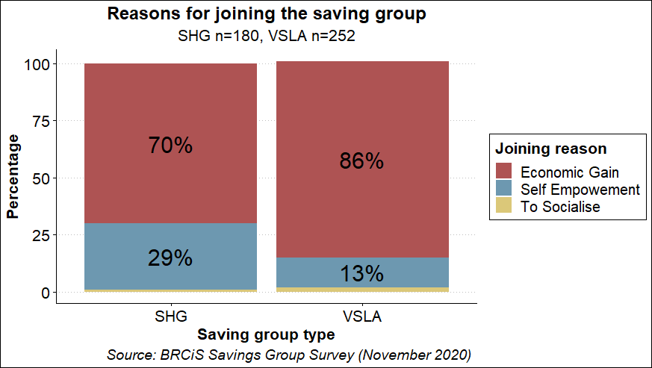
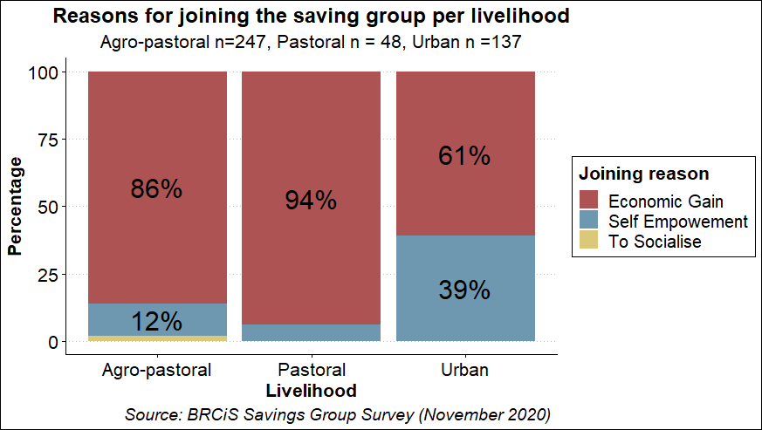
Household-level benefits
Participants of SGHs value self-empowerment more than in VSLAs
Empowerment propelled about one third of SHGs to join the group
This reasoning was much more common in urban areas
Notes:
Insert caption directly in the visuals

Slide 27
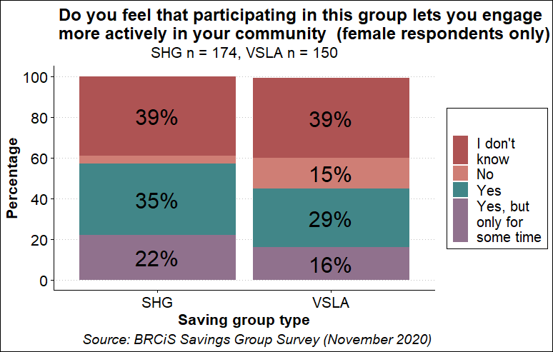
Female empowerment
However, when looking at the perception of female members, both VSLAs and SHGs seem to perform well
Notes:
Insert caption into the visual

Slide 28
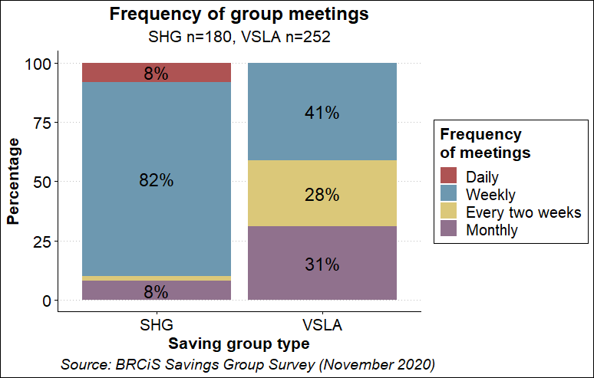
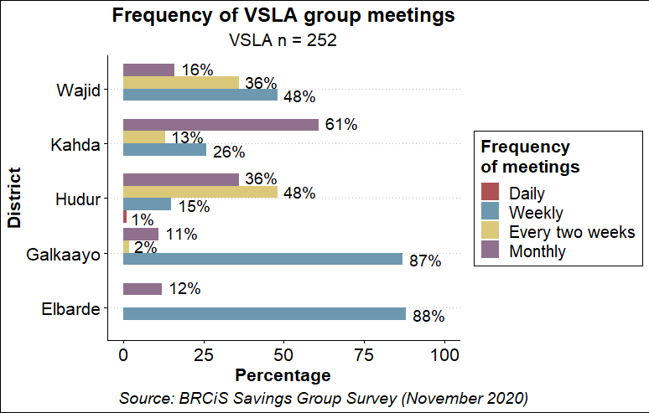
Group Performance
SHGs meet more frequently on average, when the C19 situations allows
8 in 10 SHG participants reported meeting up every week
But a small share of VSLA also gather weekly

Slide 29
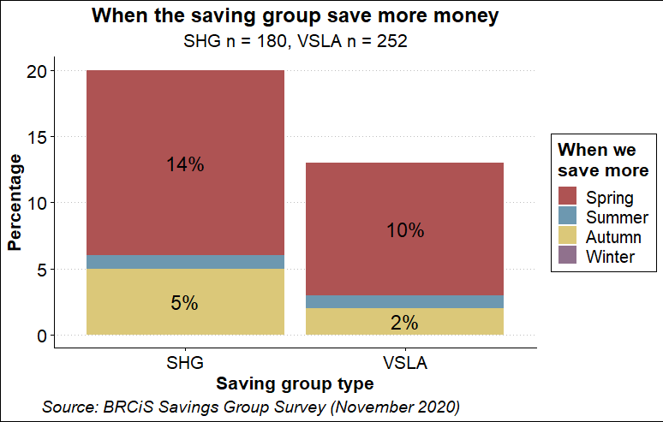
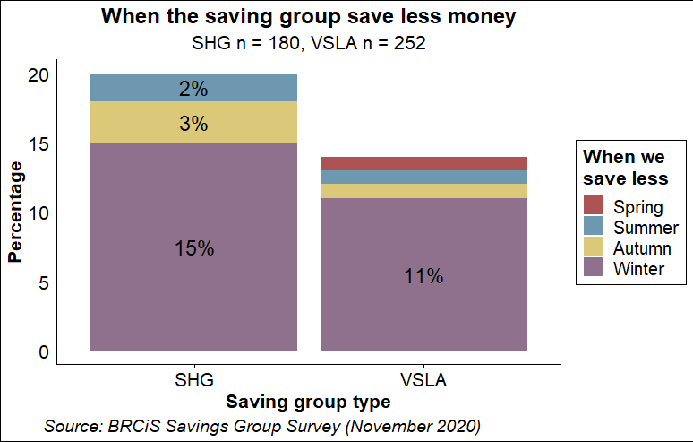
Household-level benefits
More capacity to save in Jilaal with less savings made during Deyr (findings need further unpacking)
One in ten indicated to save more Jilaal
Deyr is commonly cited as the time of the year when members report saving less

Slide 30
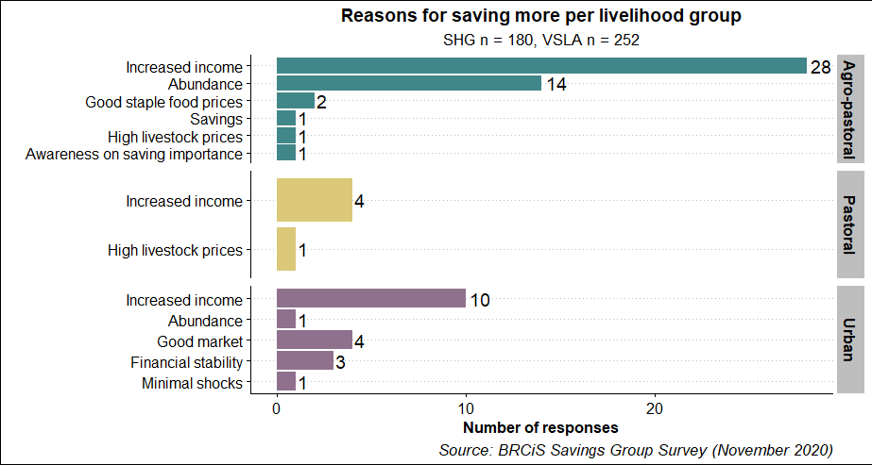
Household-level benefits
Increased savings capacity are primarily linked to increased income
Other factors influencing savings capacities involve stable food prices, good harvest, increasing livestock prices, market access and limited shock exposure

Slide 31
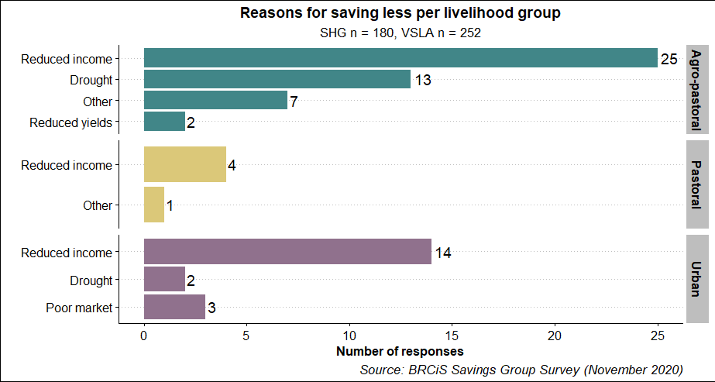
Household-level benefits
Reduced productivity caused by environment factors is one of the primary reasons for decreased savings capacities

Slide 32
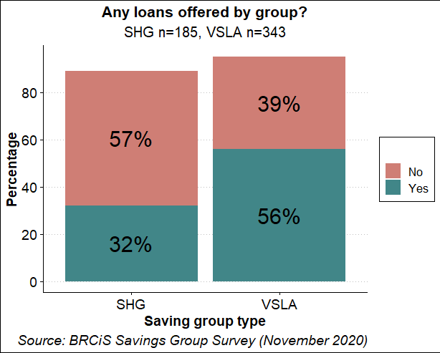
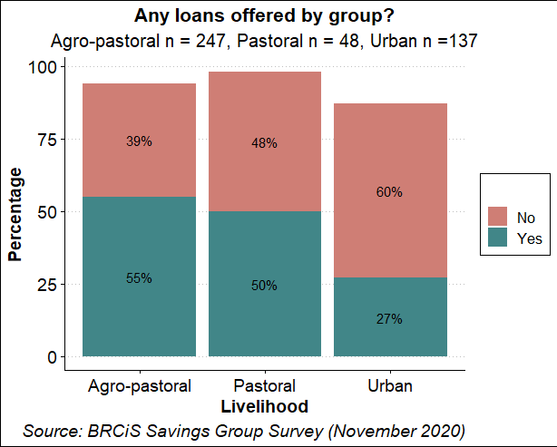
Household-level benefits
VSLAs tend to give out more loans to its Members
More than half of VSLA respondents said their group gave out loans
Group loans are more prevalent in rural areas

Slide 33
Household-level benefits
There is some significant variation across districts.
Any loans offered by group?
Type | District | Yes | No | Total
SHG | Belet-Hawa | 91.30% | 8.70% | 23
VSLA | Hudur | 74.40% | 21.40% | 117
SHG | Bardera | 70% | 20% | 20
SHG | Wanlaweyn | 64% | 28% | 25
VSLA | Galkaayo | 56.40% | 43.60% | 55
VSLA | Wajid | 40% | 48% | 25
VSLA | Elbarde | 35.30% | 47.10% | 17
VSLA | Kahda | 15.80% | 79% | 38
SHG | Bondhere | 11.10% |  | 9
SHG | Afgoye | 8% | 92% | 25
SHG | Borama | 7.70% | 92.30% | 39
SHG | Yaqshid | 7.10% | 92.90% | 14
SHG | Karaan |  | 36.40% | 11
SHG | Wadajir |  | 100% | 14
 | Total | 45.80% | 46.80% | 432

Slide 34
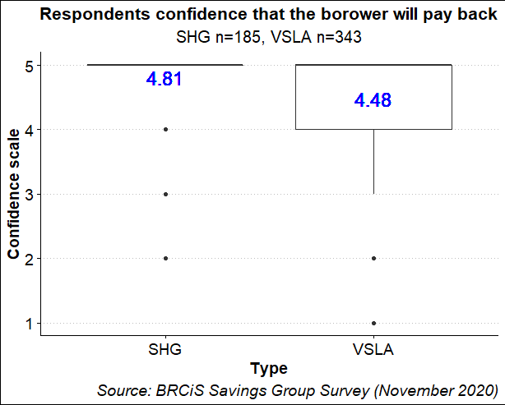
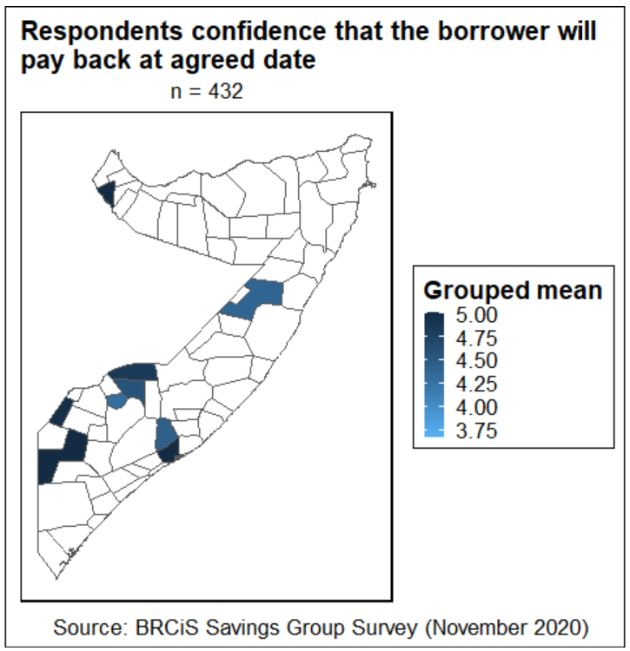
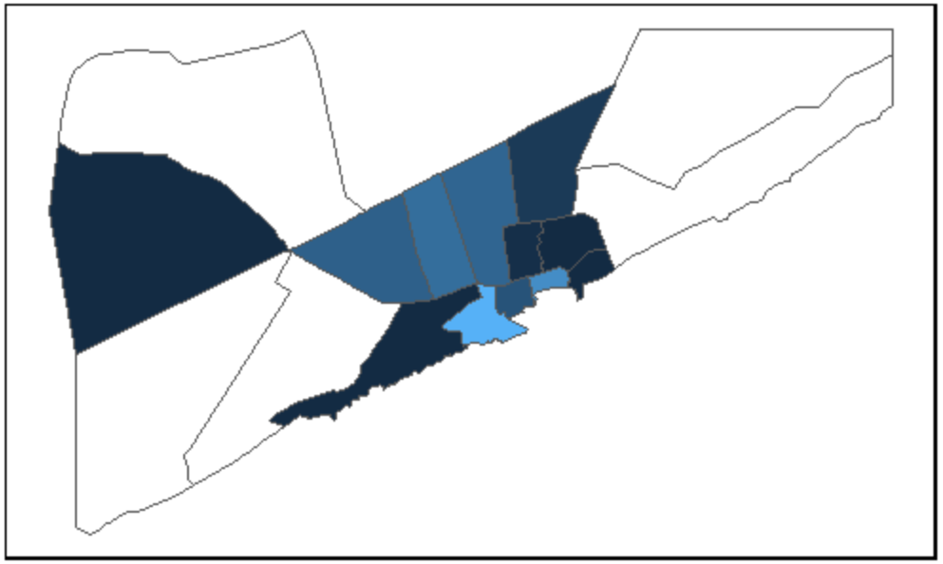
Household-level benefits
The majority of VSLA and SGH have high confidence that the borrowers will be able to pay back their loans to the group
Though, some regional variations exists
No variations between VSLAs and SHGs in group members’ confidence in others
District | Grouped mean
Afgoye | 5.0
Bardera | 5.0
Borama | 5.0
Yaqshid | 5.0
Belet-Hawa | 5.0
Elbarde | 4.8
Hudur | 4.6
Wanlaweyn | 4.4
Galkaayo | 4.4
Wajid | 4.3
Bondhere | 4.0
Kahda | 3.7

Slide 35
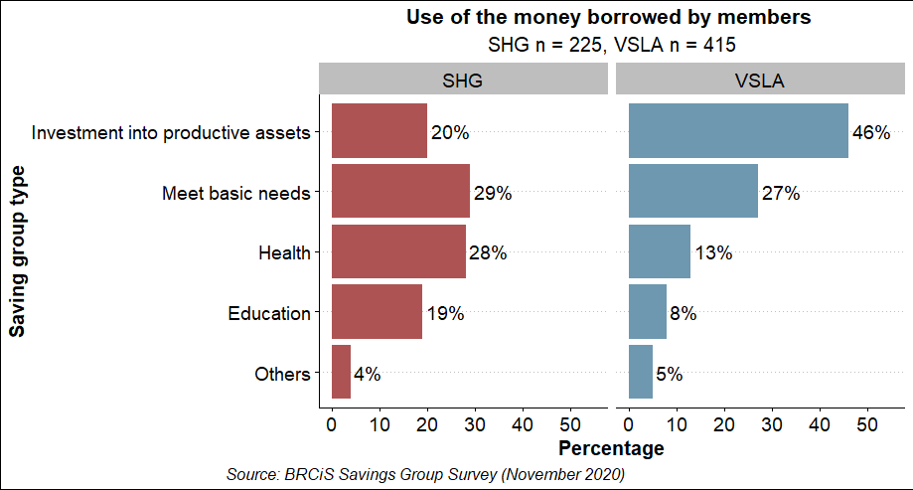
Household-level benefits
VSLA participants tend to invest more into productive assets, while SHG focus more on human capital
More than twice as much VSLA Members invest into productive assets, while SHGs focus more on health and education investments
Notes:
Meet basic needs: buy clothing, buy food, shelter
Education: shool fees
Health: medical fee
Investment into productive assets: buy farm inputs, buy livestock, invest into small business
Other: all remaining

Slide 36
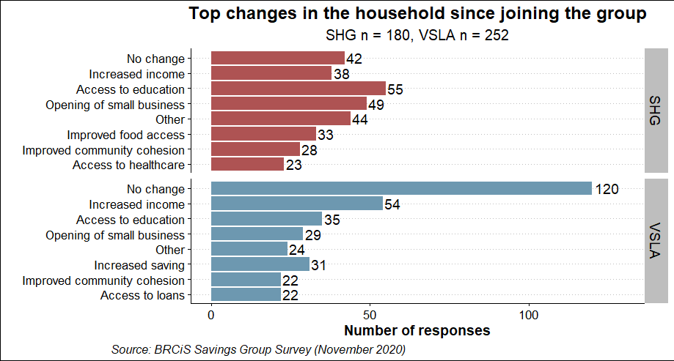
Household-level benefits
Most significant changes linked to group membership are increased income, access to education, community cohesion and self-reliance
More than one in five SHG Members reports seeing a significant impact already, primarily on income, business activity, education and food access
Around half of VSLA respondents didn’t report any impact at the time of the survey. Those who do so, most commonly cited increased income, education and savings

Slide 37
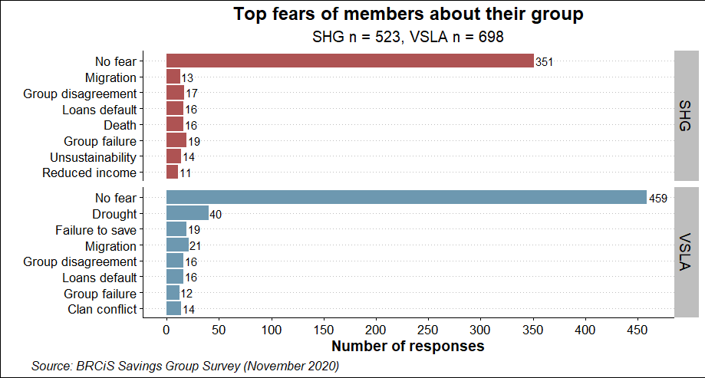
Household-level benefits
The vast majority of VSLAs and SHGs did not report any major fears

Slide 38
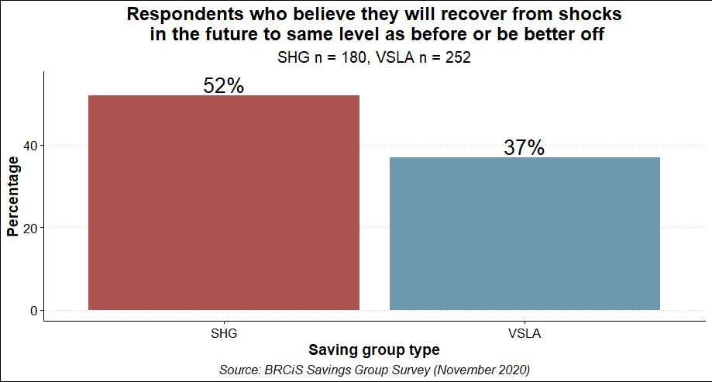
Household Resilience
SHGs report higher confidence in their capacities to recover from shocks
Notes:
Highlight percentages only, add action and add color

Slide 39
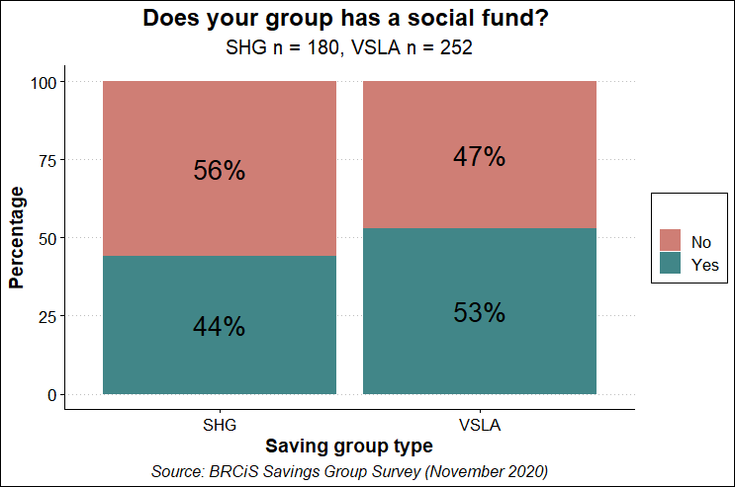
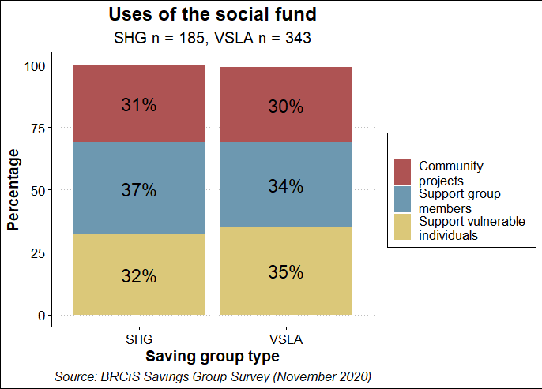
Household-level benefits
Both SHGs and VSLAs maintain social fund contributions
About half of them manages to put money aside
Primarily to support others in times of need and to contribute to community projects
Notes:
Revise caption

Slide 40
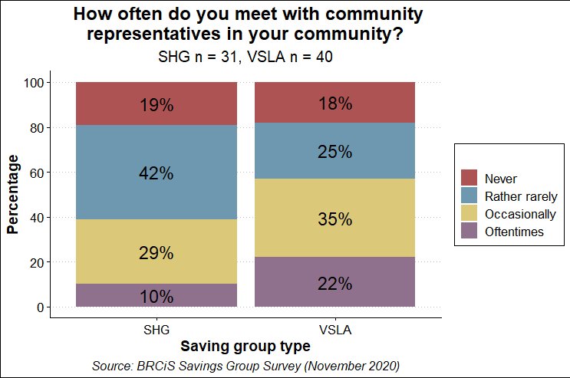
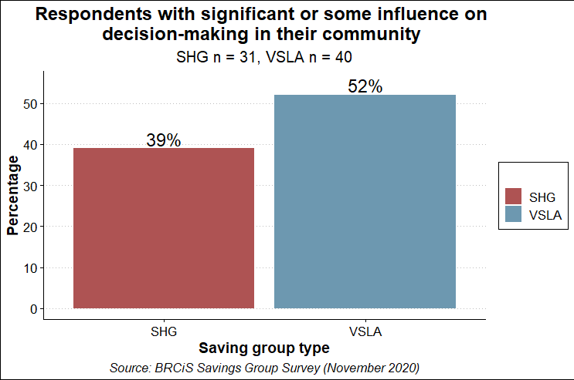
Community-wide benefits
Both VSLA and SHGs are well-embedded in their communities
Notes:
Add caption, keep % only and add color

Slide 41
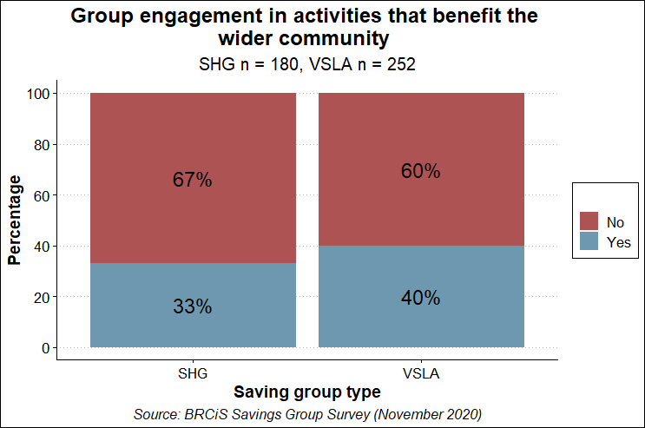
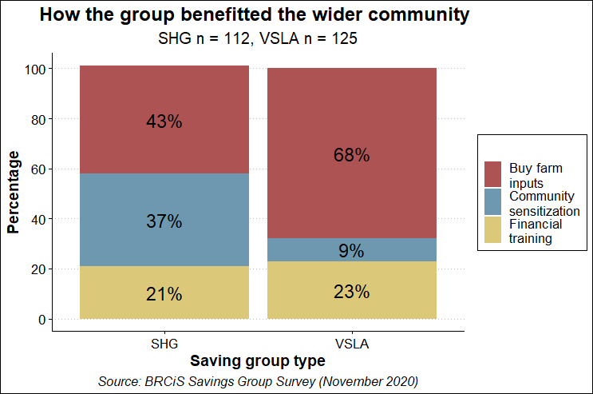
Community-wide benefits
Both of them engage in activities which benefit the wider community
Interestingly, VSLA group members report to do so slight more often
Insight on forms of assistance provided
Notes:
Add caption and revise legend to make it more readable

